Slide 1
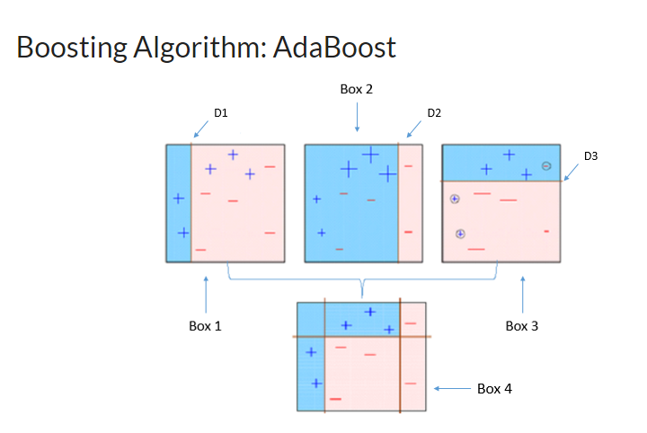
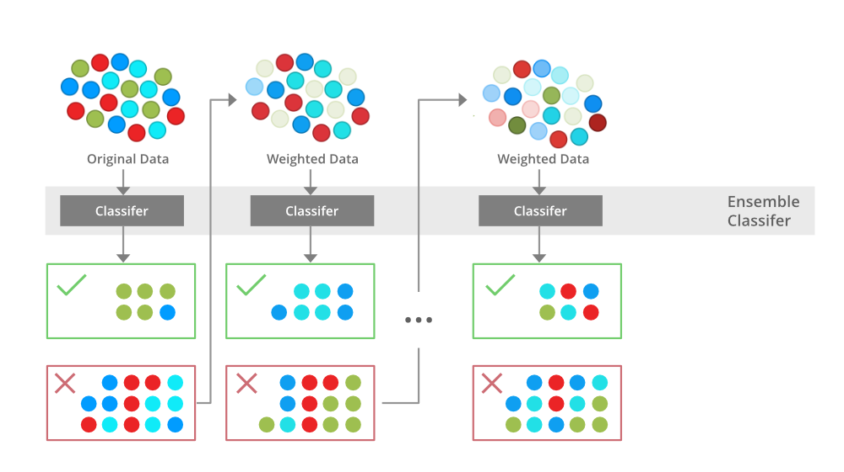
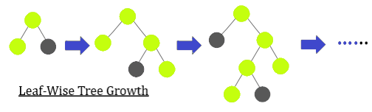
Boosting Algorithm
A single weak model may not be enough for our complex problems such cases we aggregate various weak models to make a powerful and more accurate model for our problem this process of aggregating several small problems to create a strong model is what we do in boosting
What is Boosting
Boosting is an ensemble modeling technique that attempts to build a strong classifier from the number of weak classifiers. It is done by building a model by using weak models in series.
Firstly, a model is built from the training data. Then the second model is built which tries to correct
the errors present in the first model. This procedure is continued and models are added until either the complete training data set is predicted correctly or the maximum number of models are added.
Boosting Algorithn : XG Boosting
Boosting Algorithm : LightGBM Booster

Slide 2
What is the ADA boosting algorithm in Python?
Build a model and make predictions.
Assign higher weights to miss-classified points.
Build next model.
Repeat steps 3 and 4.
Make a final model using the weighted average of individual models.

Slide 3
XGBoost
XGBoost is an implementation of Gradient Boosted decision trees.
XGBoost models majorly dominate in many Kaggle Competitions.
In this algorithm, decision trees are created in sequential form.
Weights play an important role in XGBoost.
Weights are assigned to all the independent variables
which are then fed into the decision tree which predicts results.
The weight of variables predicted wrong by the tree is increased
and these variables are then fed to the second decision tree.
These individual classifiers/predictors then ensemble to give a strong and more precise model.
It can work on regression, classification, ranking, and user-defined prediction problems.

Slide 4
LightGBM:
Different data instances have varied roles in the computation of information gain.
The instances with larger gradients(i.e., under-trained instances) will contribute more to the information gain.
GOSS keeps those instances with large gradients (e.g., larger than a predefined threshold, or among the top percentiles),
and only randomly drops those instances with small gradients to retain the accuracy of information gain estimation.
This treatment can lead to a more accurate gain estimation than uniformly random sampling,
with the same target sampling rate, especially when the value of information gain has a large range.

